Slide 1
CAR PARKING SEMULATION
BG02
1- Hayan Al-machnouk
2- Tamam Alahdal
3- Zyad Zamil
Main Algorithm Design
EE-463 Term Project

Slide 2
TABLE OF CONTENTS
01
02
03
04
05
06
INTRODUCTION
MAIN
IN-VALET
OUT-VALET
CAR GENERATION
MONITOR

Slide 3
01
INTRODUCTION

Slide 4



INTRODUCTION
INTRO
FEATURES
IMPLEMENTATION

Slide 5
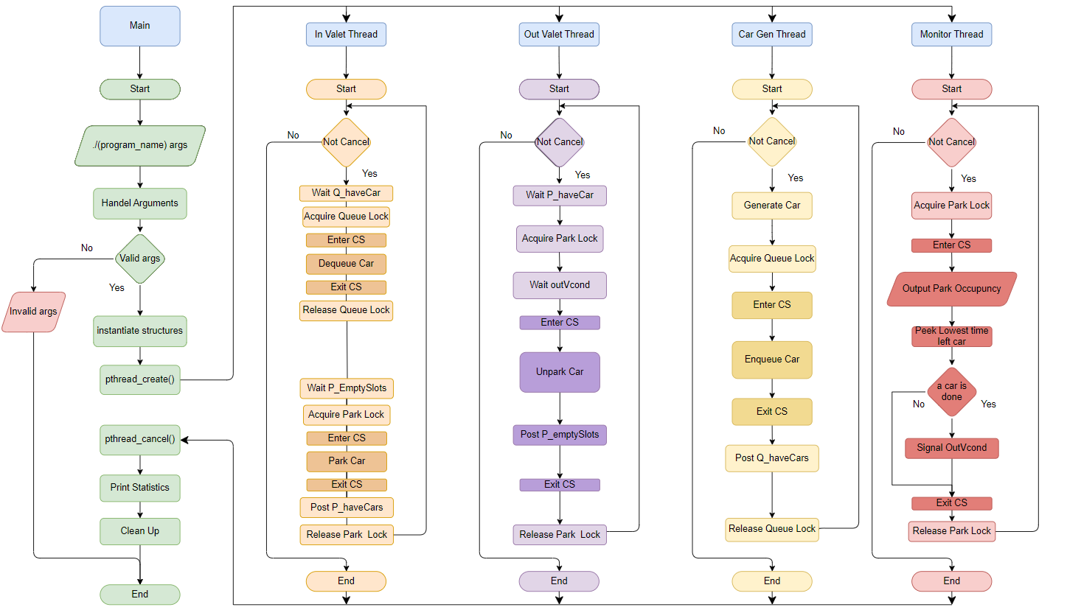
Flowchart

Slide 6
02
MAIN THREAD

Slide 7



MAIN THREAD
MAIN
ARGUMENTS
FUNCTIONS

Slide 8
03
IN-VALET THREAD

Slide 9



IN-VALET THREAD
ENTRY SECTION
CRITICAL SECTION
EXIT SECTION

Slide 10
04
OUT-VALET THREAD

Slide 11
OUT-VALET THREAD
ENTRY SECTION
CRITICAL SECTION
EXIT SECTION

Slide 12
05
CAR GENERATION THREAD

Slide 13

CAR GENERATION THREAD
ENDLESS LOOP
ENTER CS QUEUE
WAITING BEFORE ADDING CARS
EXIT CS QUEUE

Slide 14
06
MONITOR THREAD

Slide 15


MONITOR THREAD
ENTER CS PARK
UPDATING STATE
CALCULATING
EXIT CS PARK

Slide 16

THANKS!
IF YOU HAVE ANY QUESTION, PLEASE DO NOT HESITATE

